Slide 1
Chapter 1 Digital Systems and Binary Numbers
Digital Logic Design

Slide 2
Outline of Chapter 1
1.1 Digital Systems
1.2 Binary Numbers
1.3 Number-base Conversions
1.4 Octal and Hexadecimal Numbers
1.5 Complements
1.6 Signed Binary Numbers
1.7 Binary Codes
1.8 Binary Storage and Registers
1.9 Binary Logic

Slide 3
Digital Systems and Binary Numbers
Digital age and information age
Digital computers
General purposes
Many scientific, industrial and commercial applications
Digital systems
Telephone switching exchanges
Digital camera
Electronic calculators, PDA's
Digital TV
Discrete information-processing systems
Manipulate discrete elements of information
For example, {1, 2, 3, …} and {A, B, C, …}…

Slide 4
Analog and Digital Signal
Analog system
The physical quantities or signals may vary continuously over a specified range.
Digital system
The physical quantities or signals can assume only discrete values.
Greater accuracy
X(t)
X(t)
t
t
Analog signal
Digital signal

Slide 5
Binary Digital Signal
An information variable represented by physical quantity.
For digital systems, the variable takes on discrete values.
Two level, or binary values are the most prevalent values.
Binary values are represented abstractly by:
Digits 0 and 1
Words (symbols) False (F) and True (T)
Words (symbols) Low (L) and High (H)
And words On and Off
Binary values are represented by values or ranges of values of physical quantities.
V(t)
Logic 1
undefine
Logic 0
t
Binary digital signal

Slide 6
Decimal Number System
Base (also called radix) = 10
10 digits { 0, 1, 2, 3, 4, 5, 6, 7, 8, 9 }
Digit Position
Integer & fraction
Digit Weight
Weight = (Base) ^{Position}
Magnitude
Sum of “Digit x Weight”
Formal Notation
2
1
0
-1
-2
5
1
2
7
4
100
10
1
0.1
0.01
500
10
2
0.7
0.04
d₂*B²+d₁*B¹+d₀*B⁰+d₋₁*B⁻¹+d₋₂*B⁻²
(512.74)₁₀

Slide 7
Octal Number System
Base = 8
8 digits { 0, 1, 2, 3, 4, 5, 6, 7 }
Weights
Weight = (Base) ^{Position}
Magnitude
Sum of “Digit x Weight”
Formal Notation
64
8
1
1/8
1/64
5
1
2
7
4
2
1
0
-1
-2
5 *8²+1 *8¹+2 *8⁰+7 *8⁻¹+4 *8⁻²
=(330.9375)₁₀
(512.74)₈

Slide 8
Binary Number System
Base = 2
2 digits { 0, 1 }, called binary digits or “bits”
Weights
Weight = (Base) ^{Position}
Magnitude
Sum of “Bit x Weight”
Formal Notation
Groups of bits 4 bits = Nibble
8 bits = Byte
4
2
1
1/2
1/4
1
0
1
0
1
2
1
0
-1
-2
1 *2²+0 *2¹+1 *2⁰+0 *2⁻¹+1 *2⁻²
=(5.25)₁₀
(101.01)₂
1 0 1 1
1 1 0 0 0 1 0 1

Slide 9
Hexadecimal Number System
Base = 16
16 digits { 0, 1, 2, 3, 4, 5, 6, 7, 8, 9, A, B, C, D, E, F }
Weights
Weight = (Base) ^{Position}
Magnitude
Sum of “Digit x Weight”
Formal Notation
256
16
1
1/16
1/256
1
E
5
7
A
2
1
0
-1
-2
1 *16²+14 *16¹+5 *16⁰+7 *16⁻¹+10 *16⁻²
=(485.4765625)₁₀
(1E5.7A)₁₆

Slide 10
The Power of 2
n | 2^{n}
0 | 2⁰=1
1 | 2¹=2
2 | 2²=4
3 | 2³=8
4 | 2⁴=16
5 | 2⁵=32
6 | 2⁶=64
7 | 2⁷=128
n | 2^{n}
8 | 2⁸=256
9 | 2⁹=512
10 | 2¹⁰=1024
11 | 2¹¹=2048
12 | 2¹²=4096
20 | 2²⁰=1M
30 | 2³⁰=1G
40 | 2⁴⁰=1T
Kilo
Mega
Giga
Tera

Slide 11
Addition
Decimal Addition
1
1
Carry
5
5
+
5
5
1
1
0
= Ten ≥ Base
➔ Subtract a Base

Slide 12
Binary Addition
Column Addition
1
1
1
1
1
1
1
1
1
1
0
1
= 61
= 23
+
1
0
1
1
1
1
0
1
0
1
0
0
= 84
≥ (2)₁₀

Slide 13
Binary Subtraction
Borrow a “Base” when needed
1
2
= (10)₂
0
2
2
0
0
2
1
0
0
1
1
0
1
= 77
= 23
−
1
0
1
1
1
0
1
1
0
1
1
0
= 54

Slide 14
Binary Multiplication
Bit by bit
1
0
1
1
1
x
1
0
1
0
0
0
0
0
0
1
0
1
1
1
0
0
0
0
0
1
0
1
1
1
1
1
1
0
0
1
1
0

Slide 15
Number Base Conversions
Evaluate Magnitude
Octal
(Base 8)
Evaluate Magnitude
Decimal
(Base 10)
Binary
(Base 2)
Hexadecimal
(Base 16)
Evaluate Magnitude

Slide 16
Decimal (Integer) to Binary Conversion
Divide the number by the ‘Base’ (=2)
Take the remainder (either 0 or 1) as a coefficient
Take the quotient and repeat the division
Example: (13)₁₀
Quotient
Remainder
Coefficient
13
/ 2 = 6
1 a₀ = 1
6
/ 2 = 3
0 a₁ = 0
3
/ 2 = 1
1 a₂ = 1
1
/ 2 = 0
1 a₃ = 1
Answer: (13)₁₀ = (a₃ a₂ a₁ a₀)₂ = (1101)₂
MSB LSB

Slide 17
Decimal (Fraction) to Binary Conversion
Multiply the number by the ‘Base’ (=2)
Take the integer (either 0 or 1) as a coefficient
Take the resultant fraction and repeat the division
Example: (0.625)₁₀
Integer
Fraction
Coefficient
0.625
* 2 = 1 . 25
a₋₁ = 1
0.25
* 2 = 0 . 5 a₋₂ = 0
0.5
* 2 = 1 . 0 a₋₃ = 1
Answer: (0.625)₁₀ = (0.a₋₁ a₋₂ a₋₃)₂ = (0.101)₂
MSB LSB

Slide 18
Decimal to Octal Conversion
Example: (175)₁₀
Quotient
Remainder
Coefficient
175
/ 8 = 21
7 a₀ = 7
21
/ 8 = 2
5 a₁ = 5
2
/ 8 = 0
2 a₂ = 2
Answer: (175)₁₀ = (a₂ a₁ a₀)₈ = (257)₈
Example: (0.3125)₁₀
Integer
Fraction
Coefficient
0.3125
* 8 = 2 . 5
a₋₁ = 2
0.5
* 8 = 4 . 0 a₋₂ = 4
Answer: (0.3125)₁₀ = (0.a₋₁ a₋₂ a₋₃)₈ = (0.24)₈

Slide 19
Binary − Octal Conversion
Octal | Binary
0 | 0 0 0
1 | 0 0 1
2 | 0 1 0
3 | 0 1 1
4 | 1 0 0
5 | 1 0 1
6 | 1 1 0
7 | 1 1 1
8 = 2³
Each group of 3 bits represents an octal digit
Example:
Assume Zeros
( 1 0 1 1 0 . 0 1 )₂
( 2 6 . 2 )₈
Works both ways (Binary to Octal & Octal to Binary)

Slide 20
Binary − Hexadecimal Conversion
Hex | Binary
0 | 0 0 0 0
1 | 0 0 0 1
2 | 0 0 1 0
3 | 0 0 1 1
4 | 0 1 0 0
5 | 0 1 0 1
6 | 0 1 1 0
7 | 0 1 1 1
8 | 1 0 0 0
9 | 1 0 0 1
A | 1 0 1 0
B | 1 0 1 1
C | 1 1 0 0
D | 1 1 0 1
E | 1 1 1 0
F | 1 1 1 1
16 = 2⁴
Each group of 4 bits represents a hexadecimal digit
Example:
Assume Zeros
( 1 0 1 1 0 . 0 1 )₂
( 1 6 . 4 )₁₆
Works both ways (Binary to Hex & Hex to Binary)

Slide 21
Octal − Hexadecimal Conversion
Convert to Binary as an intermediate step
Example:
( 2 6 . 2 )₈
Assume Zeros
Assume Zeros
( 0 1 0 1 1 0 . 0 1 0 )₂
( 1 6 . 4 )₁₆
Works both ways (Octal to Hex & Hex to Octal)

Slide 22
Decimal, Binary, Octal and Hexadecimal
Decimal | Binary | Octal | Hex
00 | 0000 | 00 | 0
01 | 0001 | 01 | 1
02 | 0010 | 02 | 2
03 | 0011 | 03 | 3
04 | 0100 | 04 | 4
05 | 0101 | 05 | 5
06 | 0110 | 06 | 6
07 | 0111 | 07 | 7
08 | 1000 | 10 | 8
09 | 1001 | 11 | 9
10 | 1010 | 12 | A
11 | 1011 | 13 | B
12 | 1100 | 14 | C
13 | 1101 | 15 | D
14 | 1110 | 16 | E
15 | 1111 | 17 | F

Slide 23
1.5 Complements
There are two types of complements for each base-r system: the radix complement and diminished radix complement.
Diminished Radix Complement - (r-1)’s Complement
Given a number N in base r having n digits, the (r–1)’s complement of N is defined as:
(r^{n} –1) – N
Example for 6-digit decimal numbers:
9’s complement is (r^{n} – 1)–N = (10⁶–1)–N = 999999–N
9’s complement of 546700 is 999999–546700 = 453299
Example for 7-digit binary numbers:
1’s complement is (r^{n} – 1) – N = (2⁷–1)–N = 1111111–N
1’s complement of 1011000 is 1111111–1011000 = 0100111
Observation:
Subtraction from (r^{n} – 1) will never require a borrow
Diminished radix complement can be computed digit-by-digit
For binary: 1 – 0 = 1 and 1 – 1 = 0

Slide 24
Complements
1’s Complement (Diminished Radix Complement)
All ‘0’s become ‘1’s
All ‘1’s become ‘0’s
Example (10110000)₂
⇨ (01001111)₂
If you add a number and its 1’s complement …
1 0 1 1 0 0 0 0
+ 0 1 0 0 1 1 1 1
1 1 1 1 1 1 1 1

Slide 25
Complements
Radix Complement
Example: Base-10
Example: Base-2
The r's complement of an n-digit number N in base r is defined as
r^{n} – N for N ≠ 0 and as 0 for N = 0. Comparing with the (r − 1) 's complement, we note that the r's complement is obtained by adding 1 to the (r − 1) 's complement, since r^{n} – N = [(r^{n} − 1) – N] + 1.
The 10's complement of 012398 is 987602
The 10's complement of 246700 is 753300
The 2's complement of 1101100 is 0010100
The 2's complement of 0110111 is 1001001

Slide 26
Complements
2’s Complement (Radix Complement)
Take 1’s complement then add 1
Toggle all bits to the left of the first ‘1’ from the right
Example:
Number:
1’s Comp.:
OR
1 0 1 1 0 0 0 0
0 1 0 0 1 1 1 1
+ 1
1 0 1 1 0 0 0 0
0 1 0 1 0 0 0 0
0
1
0
1
0
0
0
0

Slide 27
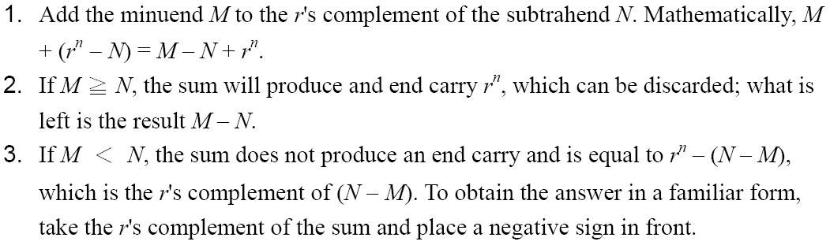
Complements
Subtraction with Complements
The subtraction of two n-digit unsigned numbers M – N in base r can be done as follows:

Slide 28
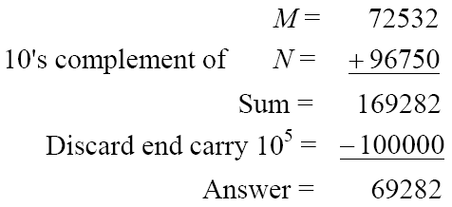
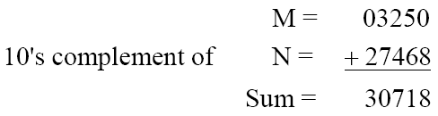
Complements
Example 1.5
Using 10's complement, subtract 72532 – 3250.
Example 1.6
Using 10's complement, subtract 3250 – 72532.
There is no end carry.
Therefore, the answer is – (10's complement of 30718) = − 69282.

Slide 29
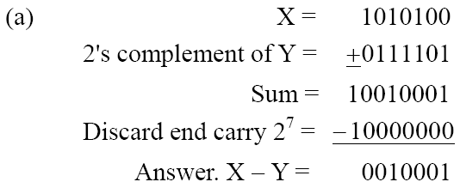
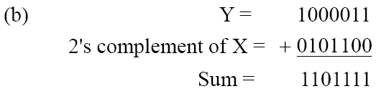
Complements
Example 1.7
Given the two binary numbers X = 1010100 and Y = 1000011, perform the subtraction (a) X – Y ; and (b) Y − X, by using 2's complement.
There is no end carry. Therefore, the answer is Y – X = − (2's complement of 1101111) = − 0010001.

Slide 30
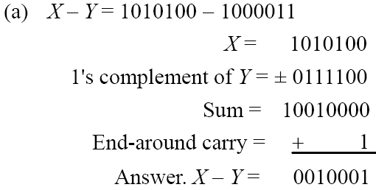
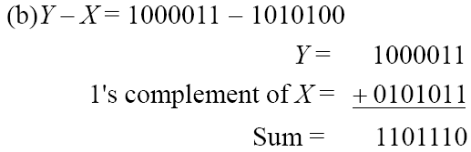
Complements
Subtraction of unsigned numbers can also be done by means of the (r − 1)'s complement. Remember that the (r − 1) 's complement is one less then the r's complement.
Example 1.8
Repeat Example 1.7, but this time using 1's complement.
There is no end carry, Therefore, the answer is Y – X = − (1's complement of 1101110) = − 0010001.

Slide 31
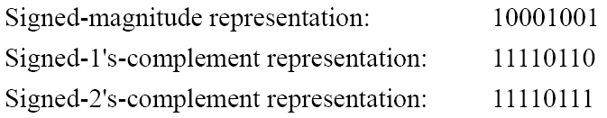
1.6 Signed Binary Numbers
To represent negative integers, we need a notation for negative values.
It is customary to represent the sign with a bit placed in the leftmost position of the number since binary digits.
The convention is to make the sign bit 0 for positive and 1 for negative.
Example:
Table 1.3 lists all possible four-bit signed binary numbers in the three representations.

Slide 32
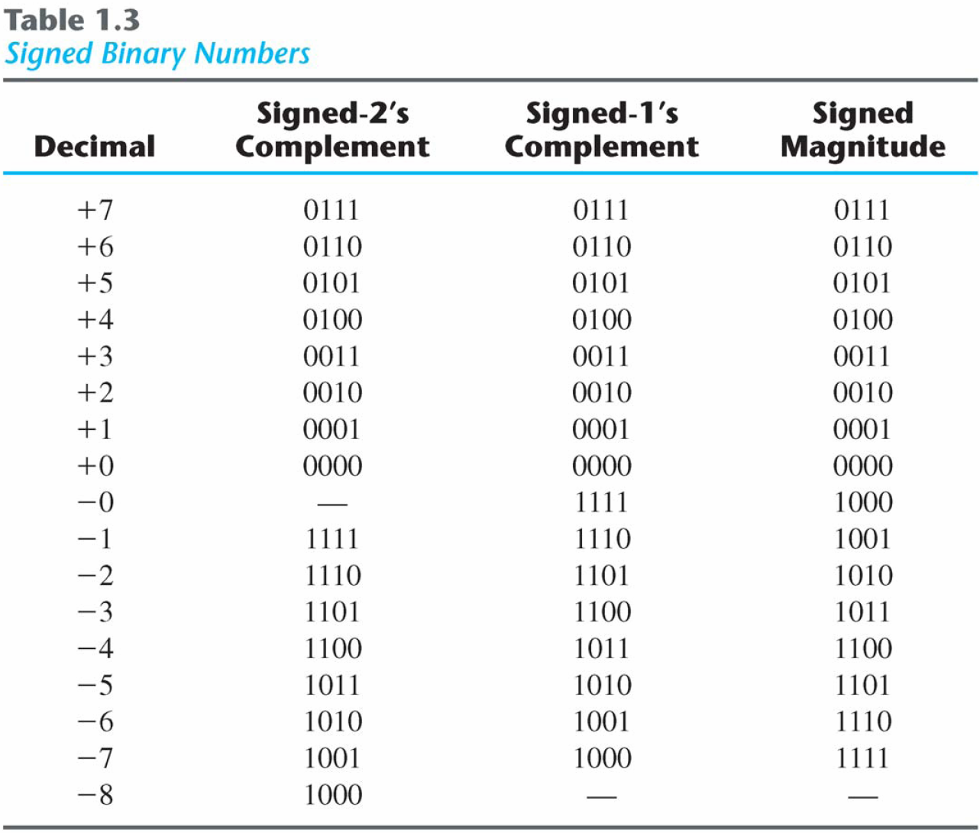
Signed Binary Numbers

Slide 33
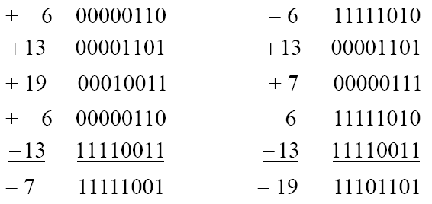
Signed Binary Numbers
Arithmetic addition
The addition of two numbers in the signed-magnitude system follows the rules of ordinary arithmetic. If the signs are the same, we add the two magnitudes and give the sum the common sign. If the signs are different, we subtract the smaller magnitude from the larger and give the difference the sign if the larger magnitude.
The addition of two signed binary numbers with negative numbers represented in signed-2's-complement form is obtained from the addition of the two numbers, including their sign bits.
A carry out of the sign-bit position is discarded.
Example:

Slide 34
Signed Binary Numbers
Arithmetic Subtraction
In 2’s-complement form:
Example:
Take the 2’s complement of the subtrahend (including the sign bit) and add it to the minuend (including sign bit).
A carry out of sign-bit position is discarded.
(− 6) − (− 13)
(11111010 − 11110011)
(11111010 + 00001101)
00000111 (+ 7)

Slide 35
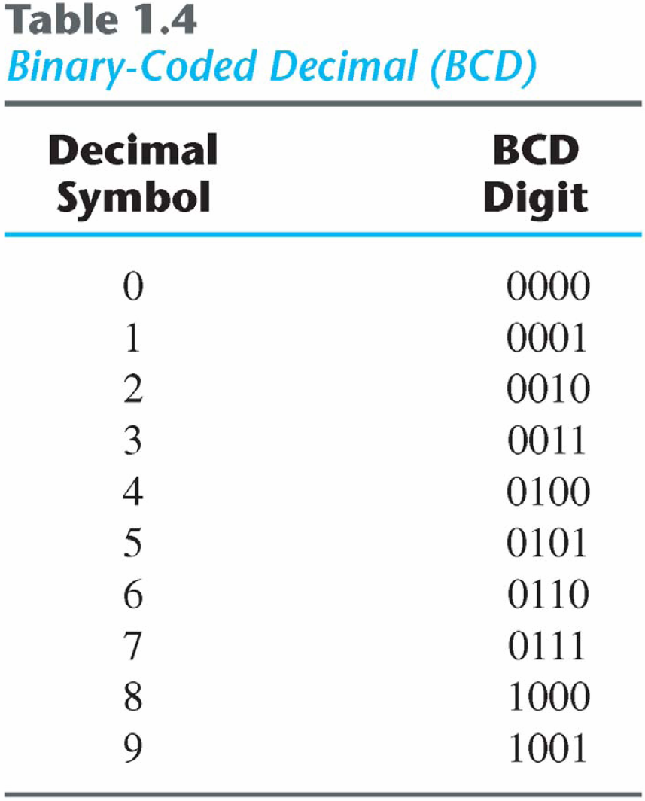
1.7 Binary Codes
BCD Code
A number with k decimal digits will require 4k bits in BCD.
Decimal 396 is represented in BCD with 12bits as 0011 1001 0110, with each group of 4 bits representing one decimal digit.
A decimal number in BCD is the same as its equivalent binary number only when the number is between 0 and 9.
The binary combinations 1010 through 1111 are not used and have no meaning in BCD.

Slide 36
Binary Code
Example:
Consider decimal 185 and its corresponding value in BCD and binary:
BCD addition

Slide 37
Binary Code
Example:
Consider the addition of 184 + 576 = 760 in BCD:
Decimal Arithmetic: (+375) + (-240) = +135
Hint 6: using 10’s of BCD

Slide 38
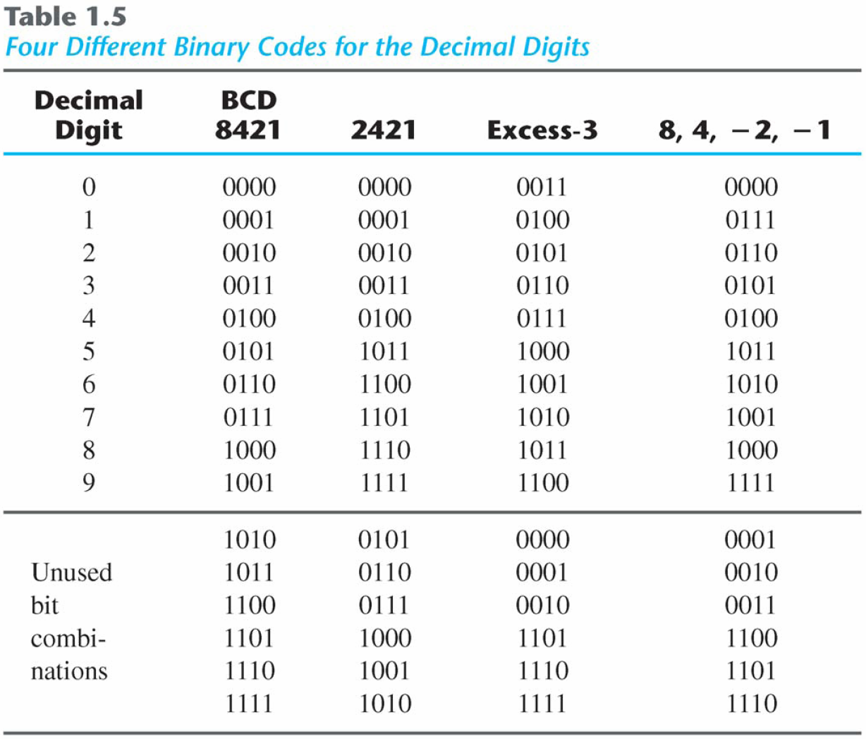
Binary Codes
Other Decimal Codes

Slide 39
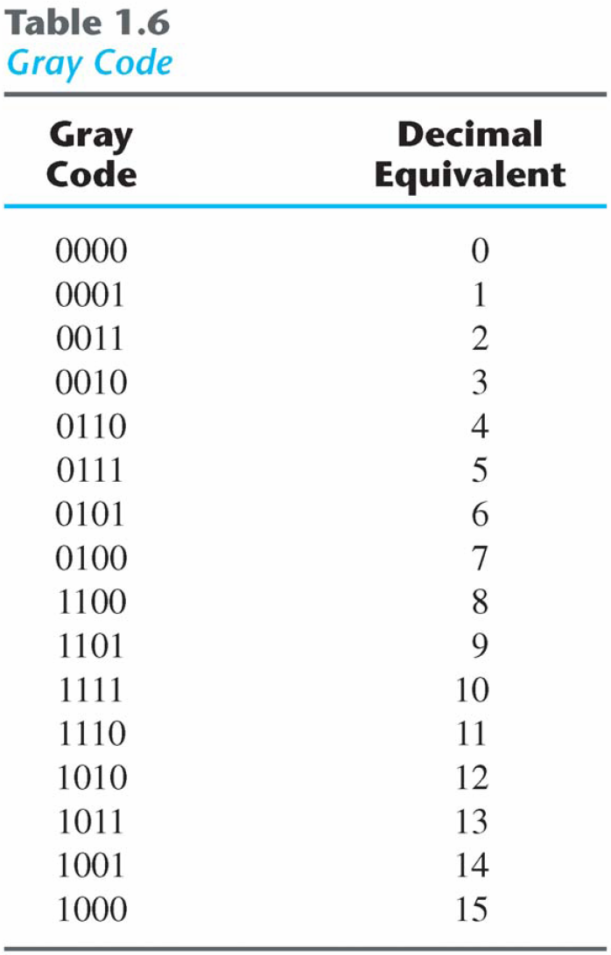
Binary Codes)
Gray Code
The advantage is that only bit in the code group changes in going from one number to the next.
Error detection.
Representation of analog data.
Low power design.
000
001
010
011
100
101
110
111
1-1 and onto!!

Slide 40
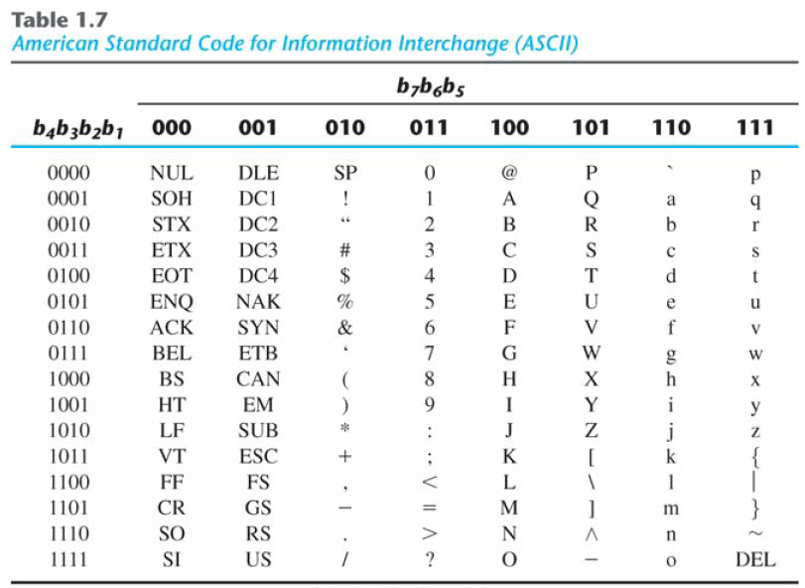
Binary Codes
American Standard Code for Information Interchange (ASCII) Character Code

Slide 41
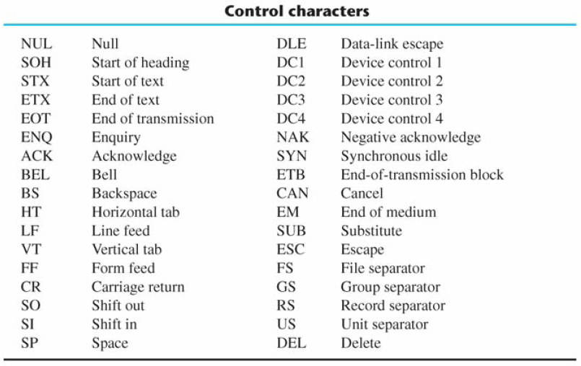
Binary Codes
ASCII Character Code

Slide 42
ASCII Character Codes
American Standard Code for Information Interchange (Refer to Table 1.7)
A popular code used to represent information sent as character-based data.
It uses 7-bits to represent:
94 Graphic printing characters.
34 Non-printing characters.
Some non-printing characters are used for text format (e.g. BS = Backspace, CR = carriage return).
Other non-printing characters are used for record marking and flow control (e.g. STX and ETX start and end text areas).

Slide 43
ASCII Properties
ASCII has some interesting properties:
Digits 0 to 9 span Hexadecimal values 30₁₆ to 39₁₆
Upper case A-Z span 41₁₆ to 5A₁₆
Lower case a-z span 61₁₆ to 7A₁₆
Lower to upper case translation (and vice versa) occurs by flipping bit 6.

Slide 44
Binary Codes
Error-Detecting Code
To detect errors in data communication and processing, an eighth bit is sometimes added to the ASCII character to indicate its parity.
A parity bit is an extra bit included with a message to make the total number of 1's either even or odd.
Example:
Consider the following two characters and their even and odd parity:

Slide 45
Binary Codes
Error-Detecting Code
Redundancy (e.g. extra information), in the form of extra bits, can be incorporated into binary code words to detect and correct errors.
A simple form of redundancy is parity, an extra bit appended onto the code word to make the number of 1’s odd or even. Parity can detect all single-bit errors and some multiple-bit errors.
A code word has even parity if the number of 1’s in the code word is even.
A code word has odd parity if the number of 1’s in the code word is odd.
Example:
Message A:
10001001
(even parity)
1
Message B:
10001001
(odd parity)
0

Slide 46
1.8 Binary Storage and Registers
Registers
A binary cell is a device that possesses two stable states and is capable of storing one of the two states.
A register is a group of binary cells. A register with n cells can store any discrete quantity of information that contains n bits.
A binary cell
Two stable state
Store one bit of information
Examples: flip-flop circuits, ferrite cores, capacitor
A register
A group of binary cells
AX in x86 CPU
Register Transfer
A transfer of the information stored in one register to another.
One of the major operations in digital system.
An example in next slides.
n cells
2^{n} possible states

Slide 47
A Digital Computer Example
Inputs: Keyboard, mouse, modem, microphone
Outputs: CRT, LCD, modem, speakers
Synchronous or Asynchronous?

Slide 48
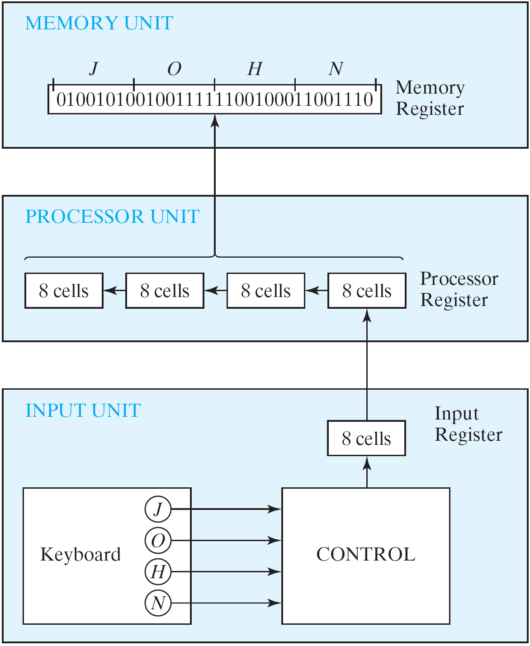
Transfer of information
Figure 1.1 Transfer of information among register

Slide 49
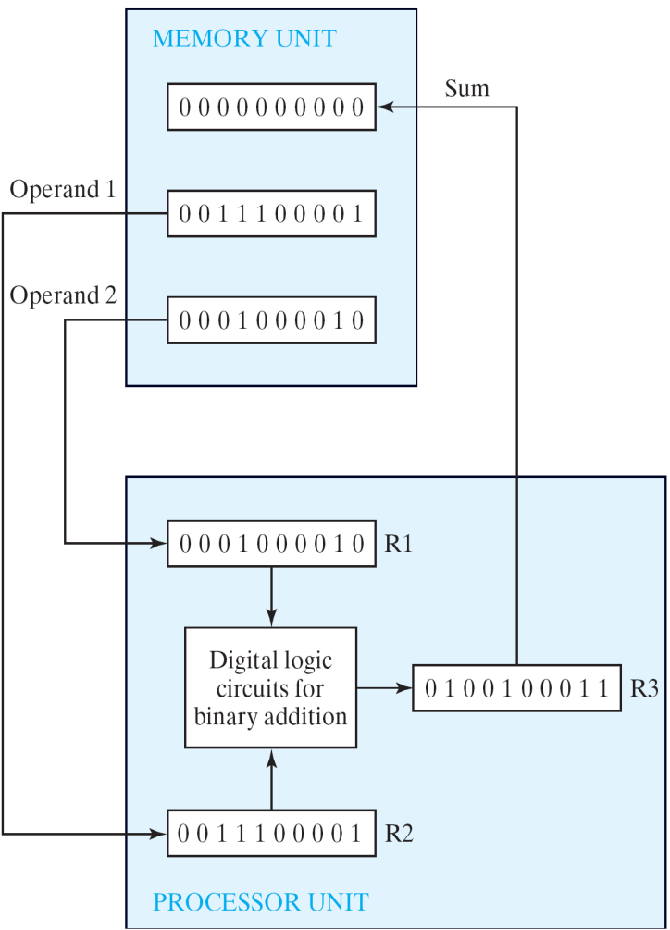
Transfer of information
The other major component of a digital system
Circuit elements to manipulate individual bits of information
Load-store machine
LD R1;
LD R2;
ADD R3, R2, R1;
SD R3;
Figure 1.2 Example of binary information processing

Slide 50
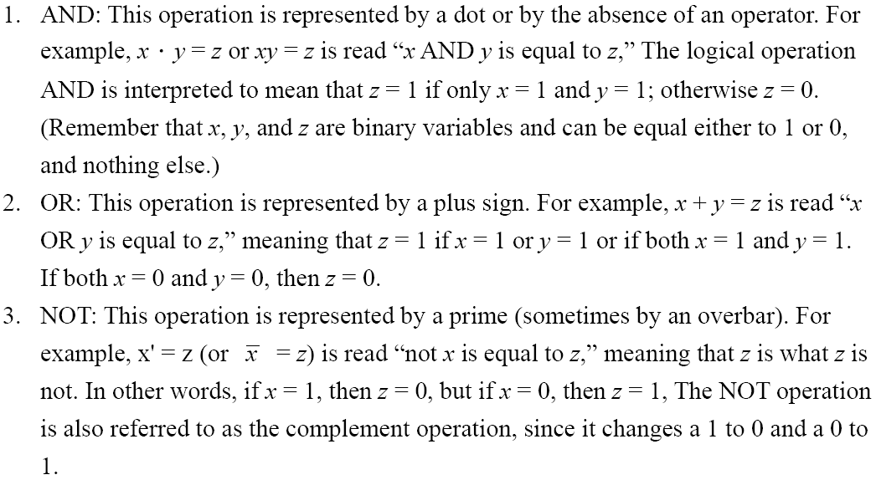
1.9 Binary Logic
Definition of Binary Logic
Binary logic consists of binary variables and a set of logical operations.
The variables are designated by letters of the alphabet, such as A, B, C, x, y, z, etc, with each variable having two and only two distinct possible values: 1 and 0,
Three basic logical operations: AND, OR, and NOT.

Slide 51
Binary Logic
Truth Tables, Boolean Expressions, and Logic Gates
AND
OR
NOT
x | y | z
0 | 0 | 0
0 | 1 | 0
1 | 0 | 0
1 | 1 | 1
x | y | z
0 | 0 | 0
0 | 1 | 1
1 | 0 | 1
1 | 1 | 1
x | z
0 | 1
1 | 0
z = x • y = x y
z = x + y
z = x = x’

Slide 52
Switching Circuits
AND
OR

Slide 53
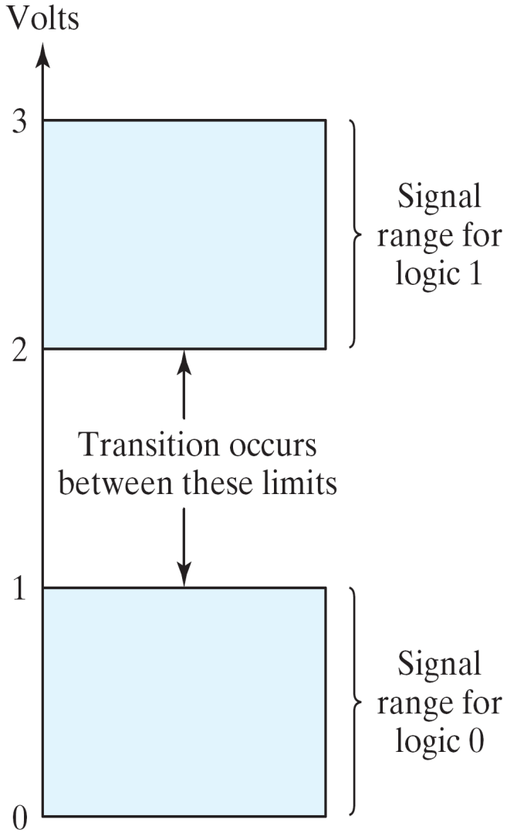
Binary Logic
Logic gates
Example of binary signals
3
Logic 1
2
Un-define
1
Logic 0
0
Figure 1.3 Example of binary signals

Slide 54
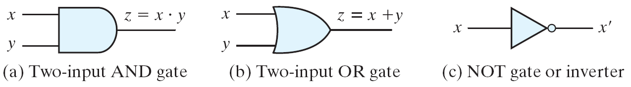
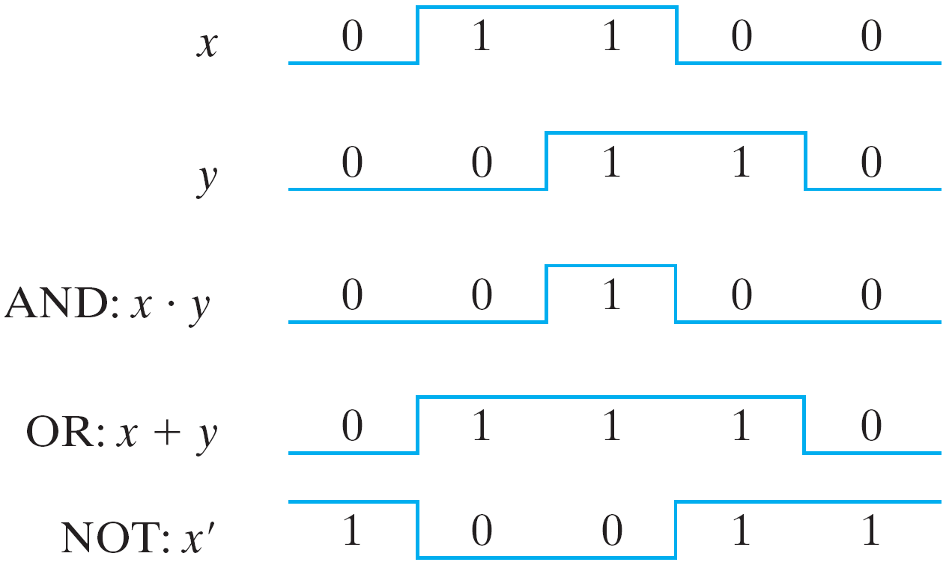
Binary Logic
Logic gates
Graphic Symbols and Input-Output Signals for Logic gates:
Fig. 1.4 Symbols for digital logic circuits
Fig. 1.5 Input-Output signals for gates

Slide 55
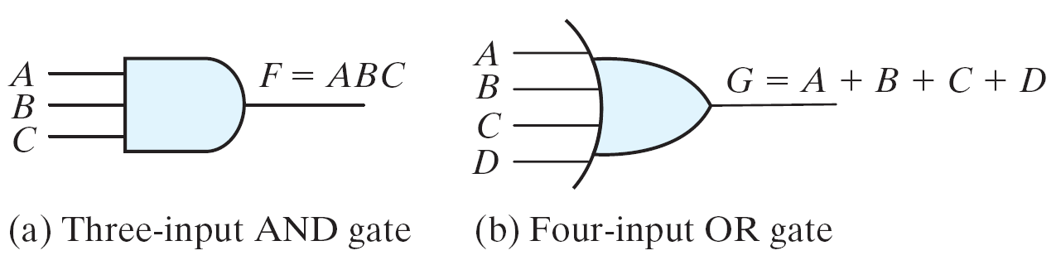
Binary Logic
Logic gates
Graphic Symbols and Input-Output Signals for Logic gates:
Fig. 1.6 Gates with multiple inputs

